Slide 1
Care and Maintenance of Computer Hardware
Prepared by Group 6 1.Amir Hamzah
2.Farha
3.Ainol Atira

Slide 2
Agenda
1.Importance of maintaining hardware
2.Tips for proper care and handling
3.Common problems and how to avoid them
4.Cleaning and safety procedures
5.Summary and quiz

Slide 3
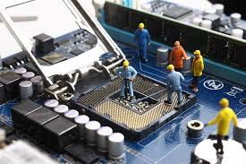
Importance of maintaining hardware
1.Enhanced performance and improve response time
-Reduce lag and improved response time
-Faster speeds
2.Extedned lifespan of hardware
-Early issue detection
-Prevent of wear and tear

Slide 4

Importance of maintaining hardware
3.Data security and protection
-Protect against malware and viruses
-Data Integrity
4.Extended lifespan of hardware
-Smooth s/w operations
-Optimal battery health

Slide 5
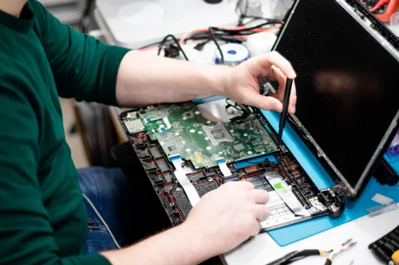
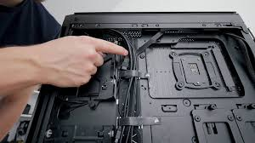

Tips for proper care and handling
Organize wire and cords
Clean CPU and other peripherals
Unplug to avoid overcharging
Run antivirus scan
Update OS
Update passwords
Unplug to avoid overcharging
Organize your data

Slide 6
Common problems and how to avoid them
1.Data loss
Problem: Accidental deletion, hardware failure, malware, or natural disaster can cause data loss.
Prevention: Regular backups, data security, human error mitigation
2.Electrical Problems
Problem: Outdated wiring, overloaded circuits, and improper installation can lead to electrical hazard.
Prevention: Regular inspection, proper wiring, overloaded prevention, unplug unused device

Slide 7
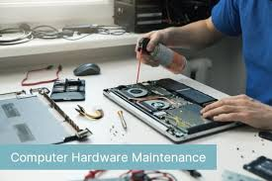
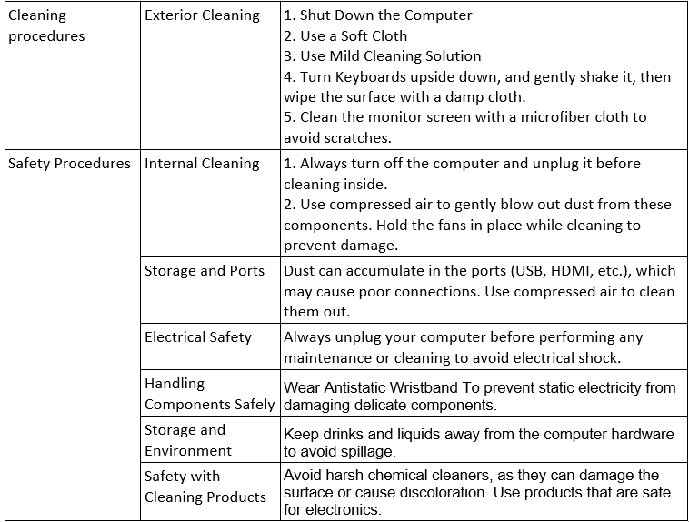

Cleaning and safety procedures

Slide 8
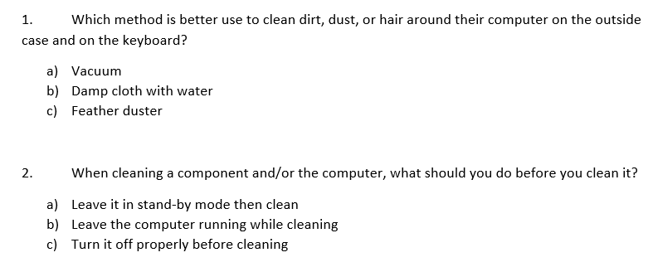
Summary and quiz
Regularly cleaning and updating your computer will ensure a longer lifespan of the device.

Slide 9
Thank you

